Slide 1
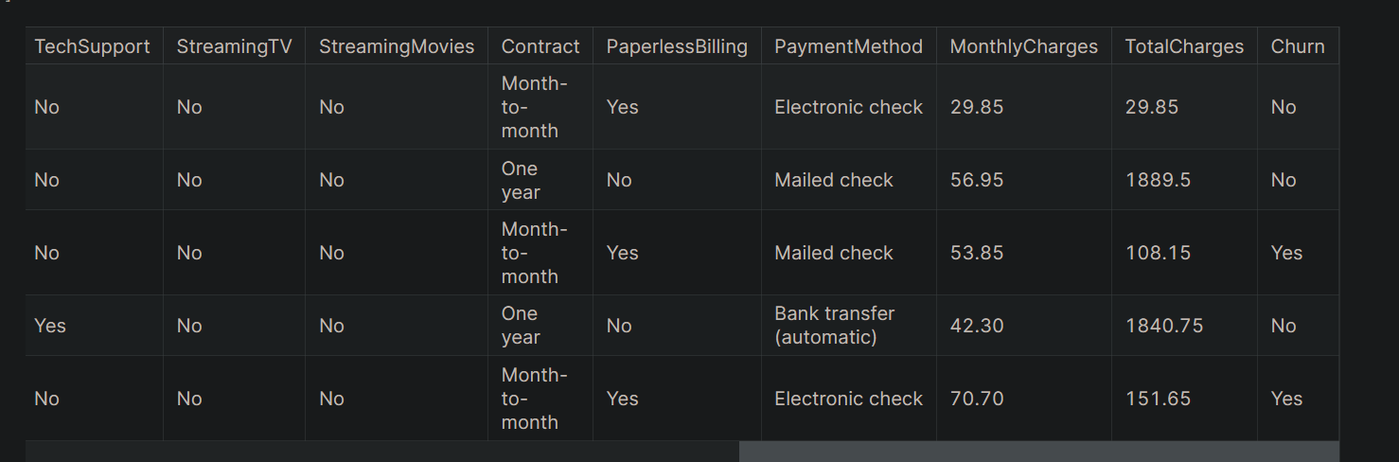

Slide 2
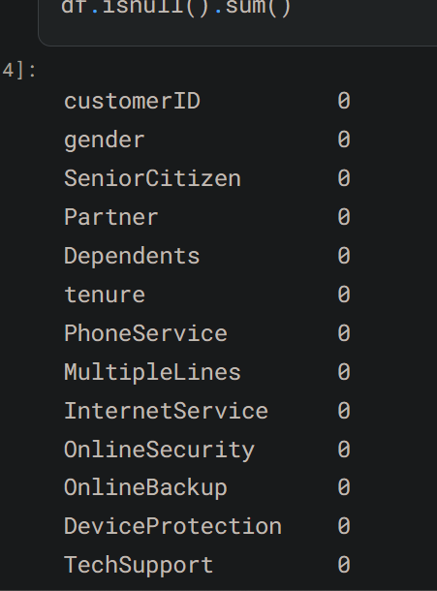
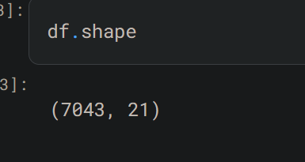
Customer_Churn classification

Slide 3
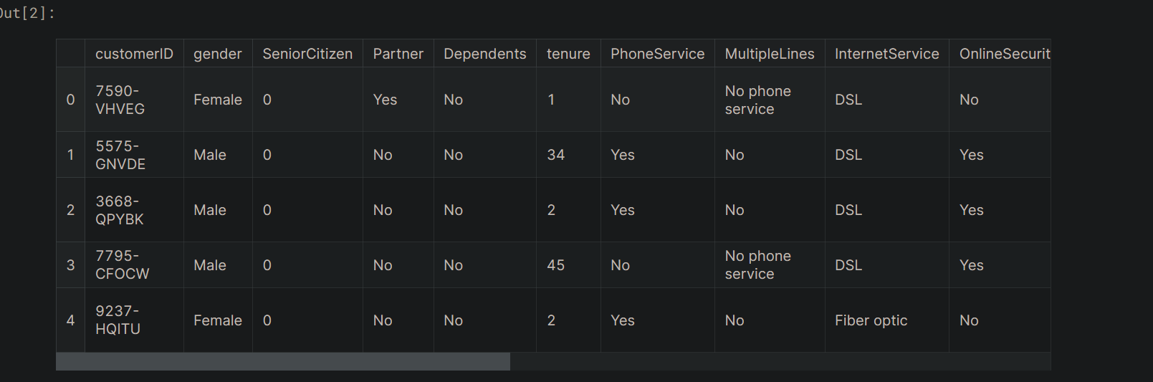

Slide 4
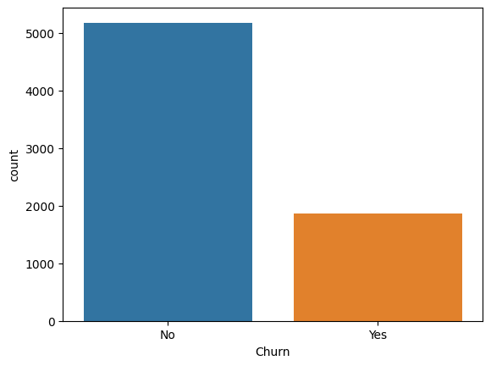


Slide 5
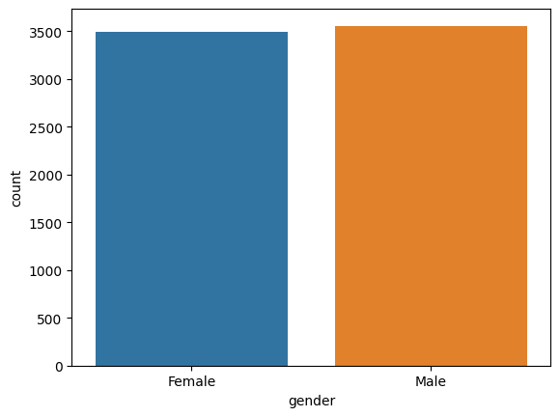
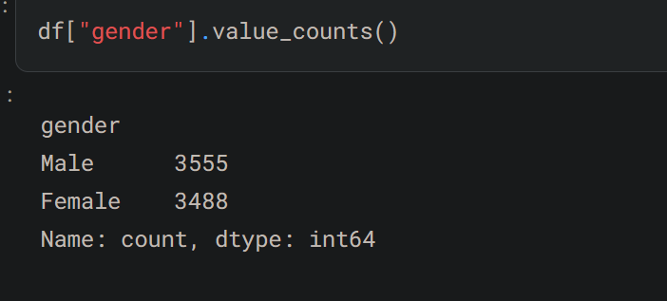

Slide 6
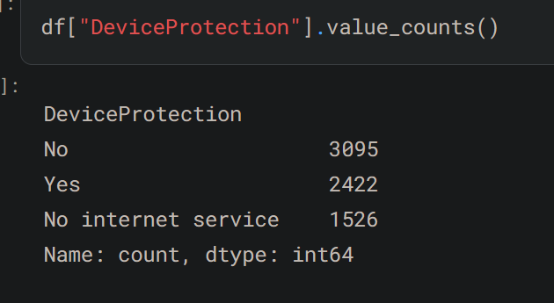
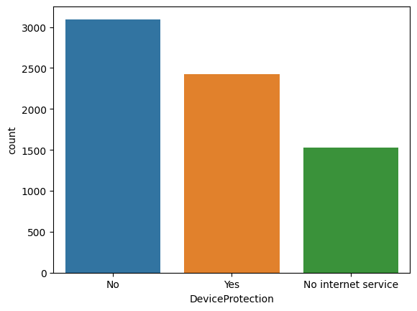

Slide 7
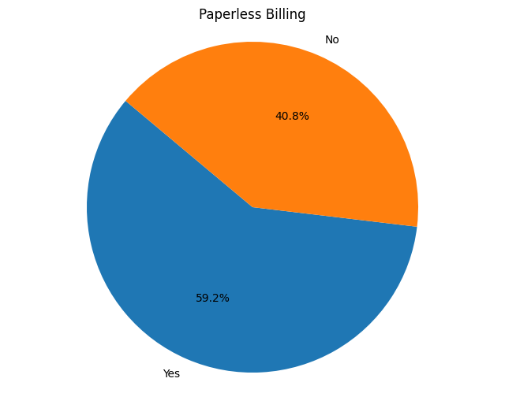
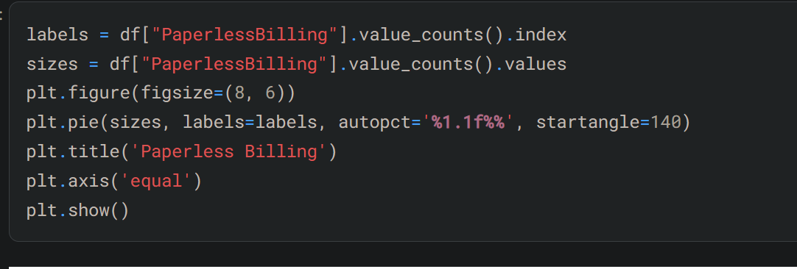

Slide 8
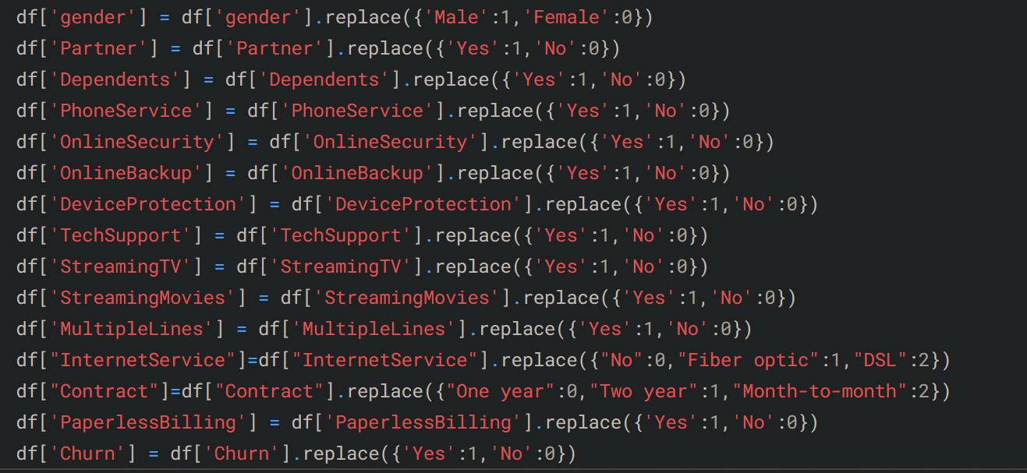

Slide 9
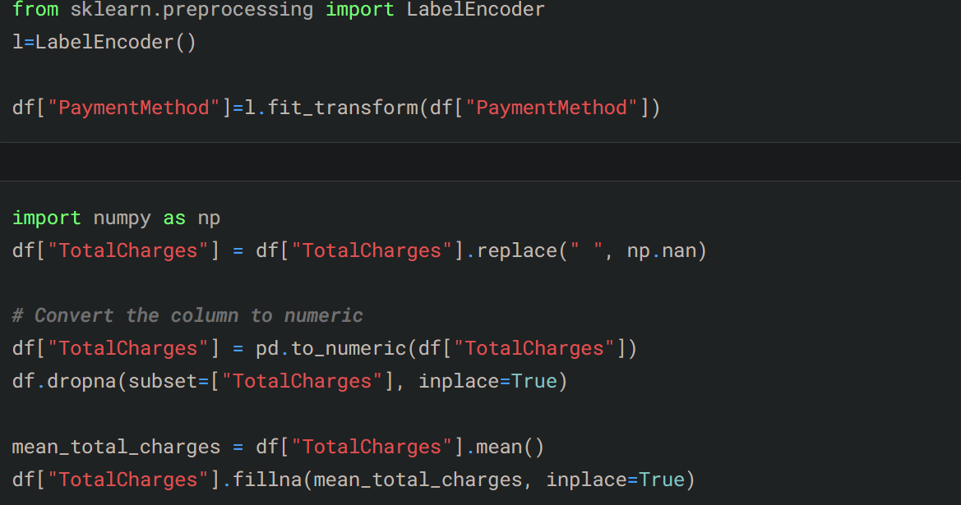

Slide 10
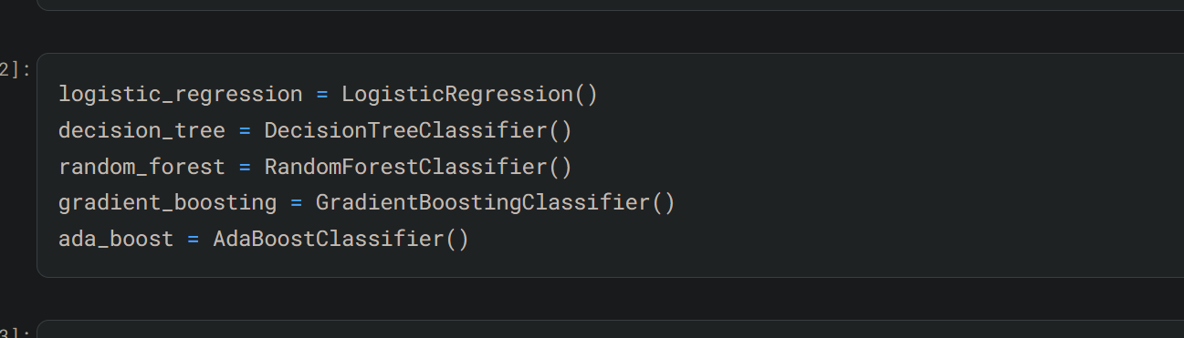

Slide 11


Slide 12
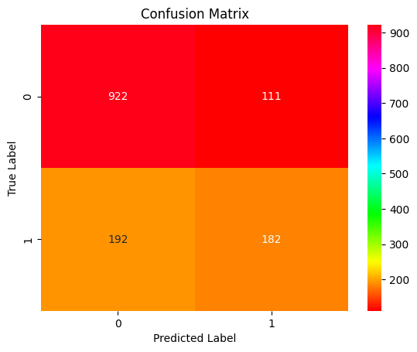
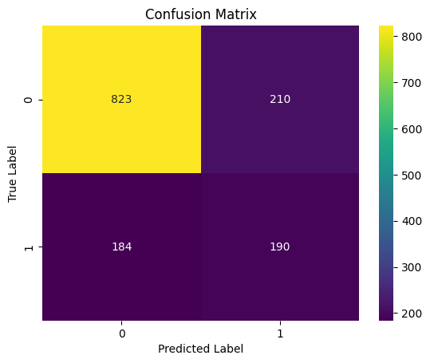

Slide 13
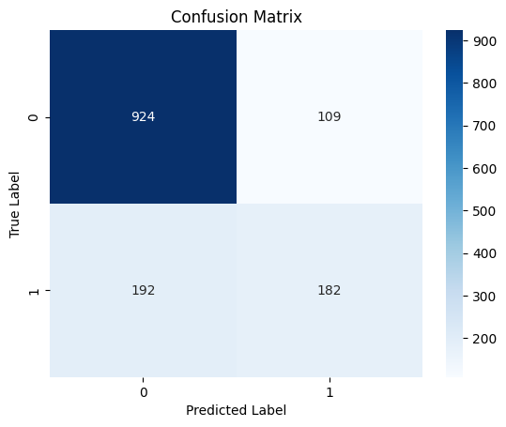
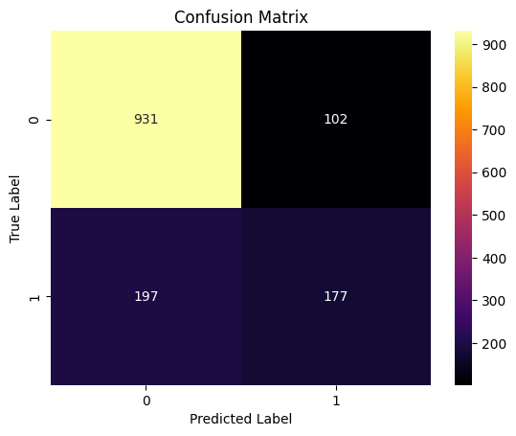

Slide 14
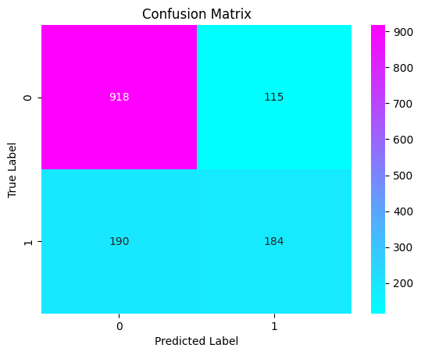

Slide 15


Slide 16


Slide 17


Slide 18


Slide 19


Slide 20


Slide 21
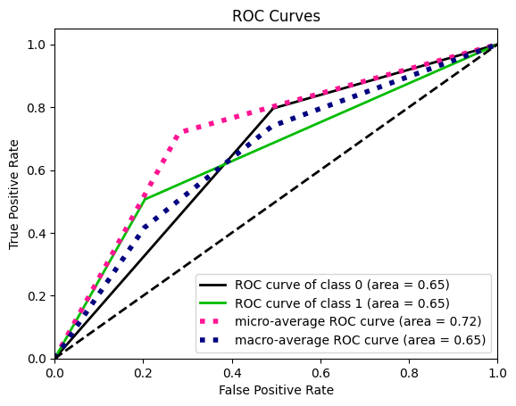

Slide 22


Slide 24


Slide 25
Recommendations:
Focus on improving customer satisfaction: Identify pain points in the customer journey and address them promptly. Utilize customer feedback mechanisms like surveys or reviews to understand areas of improvement. Offer personalized support to address individual customer needs effectively.¶
Promote Paperless Billing: Encourage customers to opt for paperless billing as it seems to be preferred by a significant portion of customers (4171 out of 7043). This can streamline the billing process, reduce administrative costs, and improve convenience for customers.

Slide 26
Enhance streaming services: Since a considerable number of customers utilize streaming services like Streaming Movies and StreamingTV, consider investing in enhancing these offerings. Negotiate for better content deals, improve streaming quality, and introduce new features to make the streaming experience more appealing.
Upsell Device Protection: There's a notable portion of customers without device protection (3095 out of 7043). Develop targeted marketing campaigns to promote the benefits of device protection services. Offer discounts or bundle deals to incentivize customers to opt for these services, thus providing added value and reducing the risk of churn.

Slide 27
Strengthen Partner relationships: With almost an equal split between customers with and without partners, focus on catering to the needs of both segments. Develop strategies to provide incentives for referrals or exclusive offers for couples, thereby strengthening loyalty among this group.¶
Target Senior Citizens: Since there's a significant number of non-senior citizens (5901 out of 7043), consider tailoring marketing efforts to attract more senior citizens. Identify services or features that are particularly appealing to this demographic and emphasize them in marketing campaigns

Slide 28
Address gender-based preferences: Analyze gender-based preferences to tailor marketing messages and service offerings more effectively. Understand the unique needs and preferences of male and female customers to provide personalized experiences that resonate with each group.
Focus on retaining existing customers: While acquiring new customers is important, retaining existing ones is equally crucial. Implement loyalty programs, special discounts for long-term customers, or exclusive offers to incentivize customers to stay with your service.

